Slide 1
Music Playlist Management System
Using Queue ADT for Playlist Management
MN. Sihanas
HND in Computing – 22
BCAS Campus Kalmunai
2025.04.12

Slide 2
Problem Statement
Build a music playlist system for adding, removing, and playing songs.
Allow both sequential playback and shuffle mode.
Use a suitable Abstract Data Type (ADT) for efficient management.

Slide 3
Selected ADT — Queue
Queue ADT follows First-In-First-Out (FIFO).
Perfect for playlists:
→ Songs are played in the same order they were added.
Operations:
  enqueue(song) → Add song.
  dequeue() → Remove song.
  traverse() → Play playlist.

Slide 4
Algorithm Design
Add Song: Insert at the end of the queue.
Remove Song: Delete from the front of the queue.
Play Songs: Sequentially traverse the queue.
Shuffle Songs: Randomly rearrange the queue list.

Slide 5




Code Demonstration
Implemented using Python.
Used:
  enqueue() for adding.
  dequeue() for removing.
  list traversal for playback.
  random.shuffle() for shuffle mode.

Slide 6
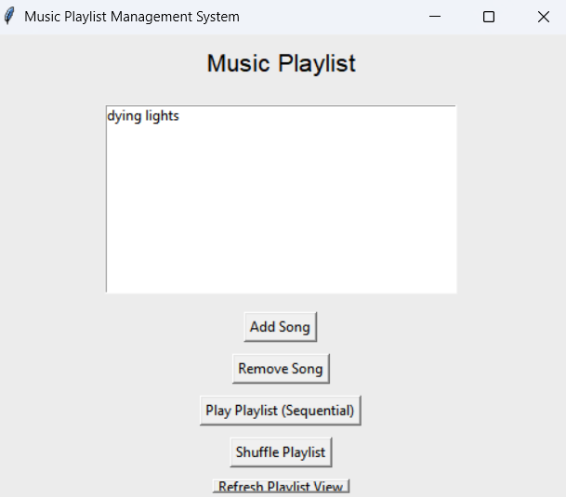
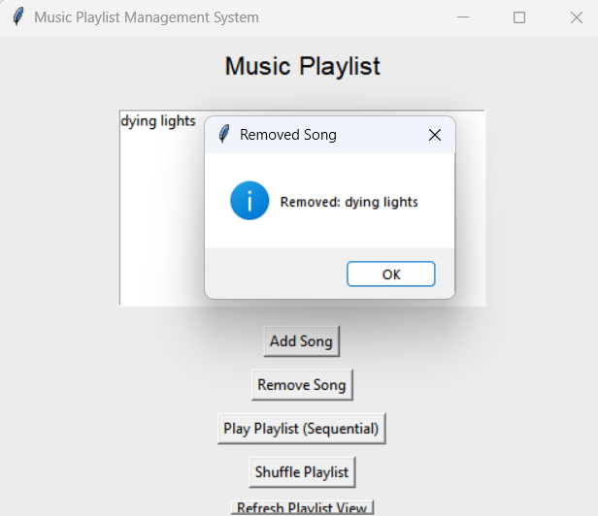
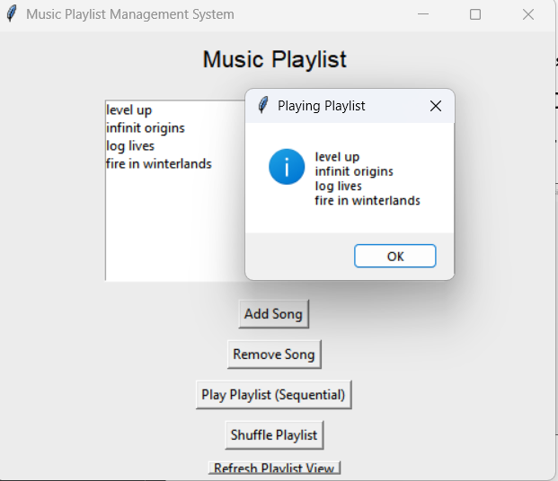
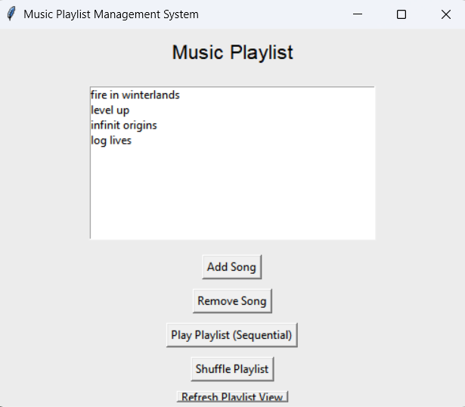
Output Demonstration
User adds, removes, and plays songs via CLI interface.
Supports both ordered play and random shuffle.

Slide 7
Conclusion
Queue ADT simplifies playlist management.
Logical, easy to expand and maintain.
Successfully passed all test cases.

